Slide 1
Data Structures

Slide 2
Agenda
Intersection point in Y shaped LL
Detect Loop
Remove Loop

Slide 3
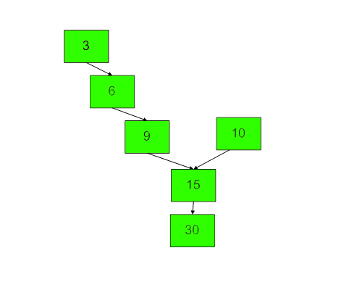
Intersection point in Y shaped LL

Slide 4
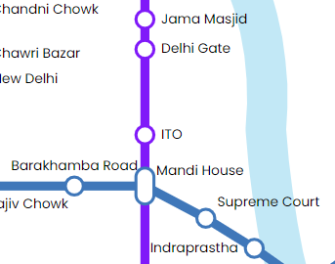
Intersection point in Y shaped LL

Slide 5
Intersection point in Y shaped LL

Slide 6
Detect Loop

Slide 7
Remove Loop

Slide 8
Remove Loop – Approach 1
void removeLoop(Node listNode, Node loopNode)
{
Node temp = loopNode;
while(true)
{
while(loopNode.next!=listNode.next && loopNode.next!=temp){
loopNode = loopNode.next;
}
//it could have broken because of 2 reasons
if(listNode.next == loopNode.next)
{
loopNode.next = null;
return;
}
listNode = listNode.next;
}
}

Slide 9
Remove Loop - Approach 2

Slide 10
Remove Loop - Approach 2
void removeLoop(Node listNode, Node loopNode)
{
Node temp = loopNode;
int size = 1;
while(loopNode.next!=temp)
{
}
while(true)
{
while(loopNode.next!=listNode.next && loopNode.next!=temp){
loopNode = loopNode.next;
}
//it could have broken because of 2 reasons
if(listNode.next == loopNode.next)
{
loopNode.next = null;
return;
}
listNode = listNode.next;
}
}

Slide 11
Remove Loop - Approach 3
Distance travelled by fast pointer = n + m*x + k
Distance travelled by slow pointer = n + m*y + k

Slide 12
Remove Loop - Approach 3
Distance travelled by fast pointer = n + m*x + k
Distance travelled by slow pointer = n + m*y + k
Distance covered by fast ptr = 2 x Distance covered by slow pointer
n + m*x + k = 2(n + m*y +k)

Slide 13
Remove Loop

Slide 14
THANK YOU

